Slide 1
Rescue Me!
Make your escape with Twilio

Slide 2
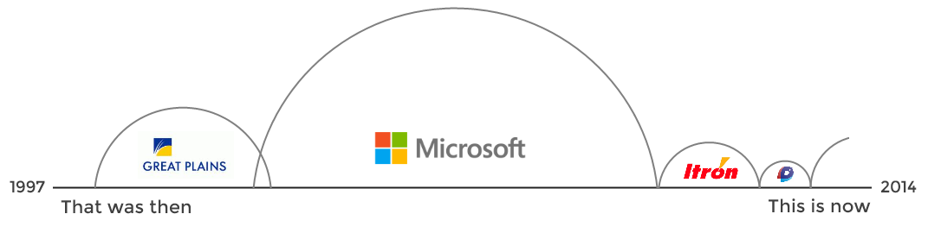
Robert Horvick

Slide 3


@bubbafat

Slide 4

Custom .NET Development and Training

Slide 5
How to get out of meetings

Slide 6


Slide 7


Slide 8


Slide 9


Slide 10


Slide 11
Escape

Slide 12
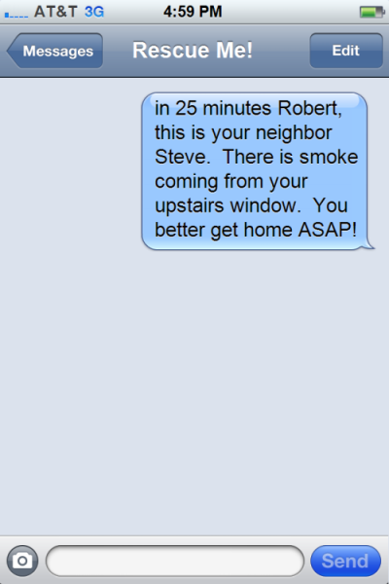

Slide 13
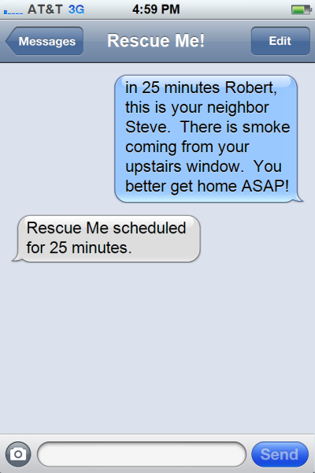

Slide 14


Slide 15
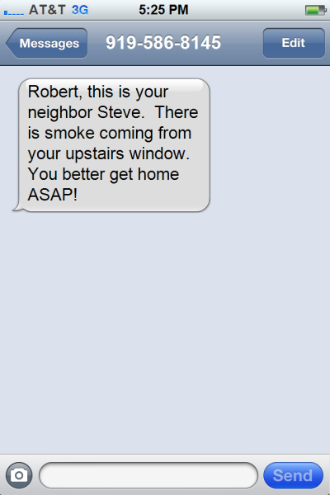

Slide 16

Freedom!

Slide 17
How would we do that?

Slide 18


Slide 19
Voice
SMS
MMS

Slide 20
Enough Talk
Let’s build something
Notes:
1) Create Empty ASP.NET Project
2) Add Twilio nuget reference
3) Add SMS Controller
[HttpPost]
public ActionResult Index(SmsRequest request)
{
TwilioResponse response = new TwilioResponse();
response.Message(request.Body);
return TwiML(response);
}
4) Publish with downloaded publishing profile (DELETE ALL EXISTING FILES!)
5) Use postman to demonstrate the POST query
http://trinugecho1.azurewebsites.net/sms/?Body=The SMS Message!
6) Talk about the XML response
Allocate a new number in Twilio and link to the site

Slide 21
public class EchoController : TwilioController
{
[HttpPost]
public ActionResult Index(SmsRequest message)
{
TwilioResponse response = new TwilioResponse();
response.Message(message.Body);
return TwiML(response);
}
}

Slide 22
public class EchoController : TwilioController
{
[HttpPost]
public ActionResult Index(SmsRequest message)
{
TwilioResponse response = new TwilioResponse();
response.Message(message.Body);
return TwiML(response);
}
}

Slide 23
public class EchoController : TwilioController
{
[HttpPost]
public ActionResult Index(SmsRequest message)
{
TwilioResponse response = new TwilioResponse();
response.Message(message.Body);
return TwiML(response);
}
}

Slide 24
public class EchoController : TwilioController
{
[HttpPost]
public ActionResult Index(SmsRequest message)
{
TwilioResponse response = new TwilioResponse();
response.Message(message.Body);
return TwiML(response);
}
}

Slide 25
public class EchoController : TwilioController
{
[HttpPost]
public ActionResult Index(SmsRequest message)
{
TwilioResponse response = new TwilioResponse();
response.Message(message.Body);
return TwiML(response);
}
}

Slide 26
public class EchoController : TwilioController
{
[HttpPost]
public ActionResult Index(SmsRequest message)
{
TwilioResponse response = new TwilioResponse();
response.Message(message.Body);
return TwiML(response);
}
}

Slide 27
TwiML?

Slide 28
<?xml version="1.0" encoding="utf-8"?>
<Response>
<Message>The SMS Message!</Message>
</Response>

Slide 29


SMS
POST
MVC
SMS
TwiML

Slide 30

SMS
POST
MVC
SMS
TwiML

Slide 31
Try It!

Slide 32

Security?

Slide 33
Things We Know…
URL Path and Query String
POST Parameters
HTTP Headers

Slide 34
Things We Hope…
The request is from Twilio

Slide 35
X-Twilio-Signature

Slide 36
X-Twilio-Signature
URL Path and Query String
POST Parameters
HMAC-SHA1 (Auth Token)

Slide 37
Shhhh…
Your authentication token is a secret.

Slide 38
ValidateRequest
Twilio Authentication: The Easy Way
Notes:
[ValidateRequest(Twilio.Config.AuthKey)]
Publish
Show it failing it PostMan
Show it working via SMS

Slide 39
Why are we building APIs using MVC?

Slide 40
Web API
Notes:
Go back to VS and create a Web API interface

Slide 41
Nope!
MVC Only
Derives from Controller
ValidateRequest uses MVC Filters

Slide 42
Twilio.WebApi
Nuget Package
Derives from ApiController
ValidateRequest works
MVC Code-Compatible

Slide 43
Web API
It’s easier, right?
Notes:
Add a new Web API Project
Web API controller
IHttpActionResult

Slide 44
Sending Messages
It’s even easier
Notes:
Add new C# console project
Add ref to Twilio
Add ref to domain
TwilioRestClient client = new TwilioRestClient(Twilio.Config.AccountSid, Twilio.Config.AuthKey); client.SendSmsMessage(Twilio.Config.From, "+19195259123", "Don't forget to get the milk!");

Slide 45
Rescue Me!

Slide 46




Slide 47
Web Role

Slide 48
Web Role
Worker Role
Azure Service Bus Queue

Slide 49
Web Role
Worker Role
Azure Service Bus Queue

Slide 50
Rescue Me!
Web, Worker and Stuff
Notes:
Controllers\SmsController.cs
Explain how CommandProcessor just figures out which command to execute
Show Help.cs (easiest command)
Show In.cs
Talk about the Service Bus queue versus Azure queues
Show OutboundMessageQueue.cs
Show WorkerRole.cs

Slide 51
919-261-3536

